Slide 1

Цифровая и микроконтроллерная техника
Vlasov Sergey
smvlasov@itmo.ru

Slide 2
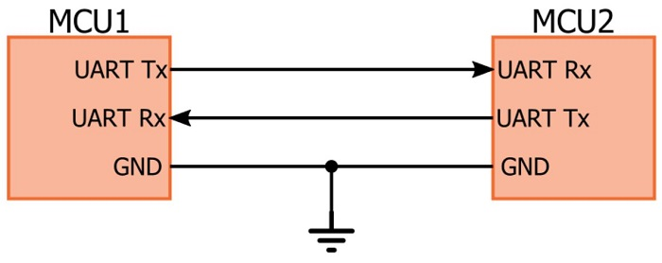
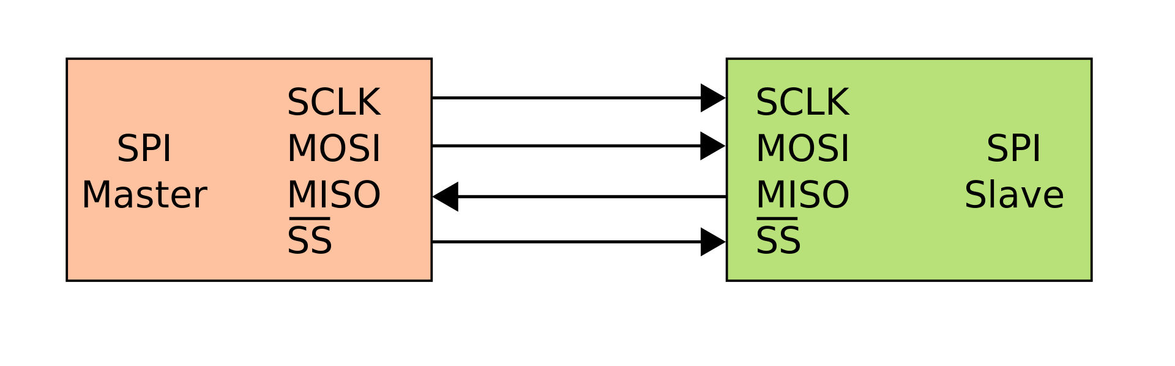
Interfaces

Slide 3
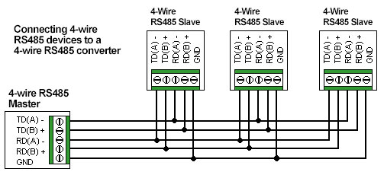
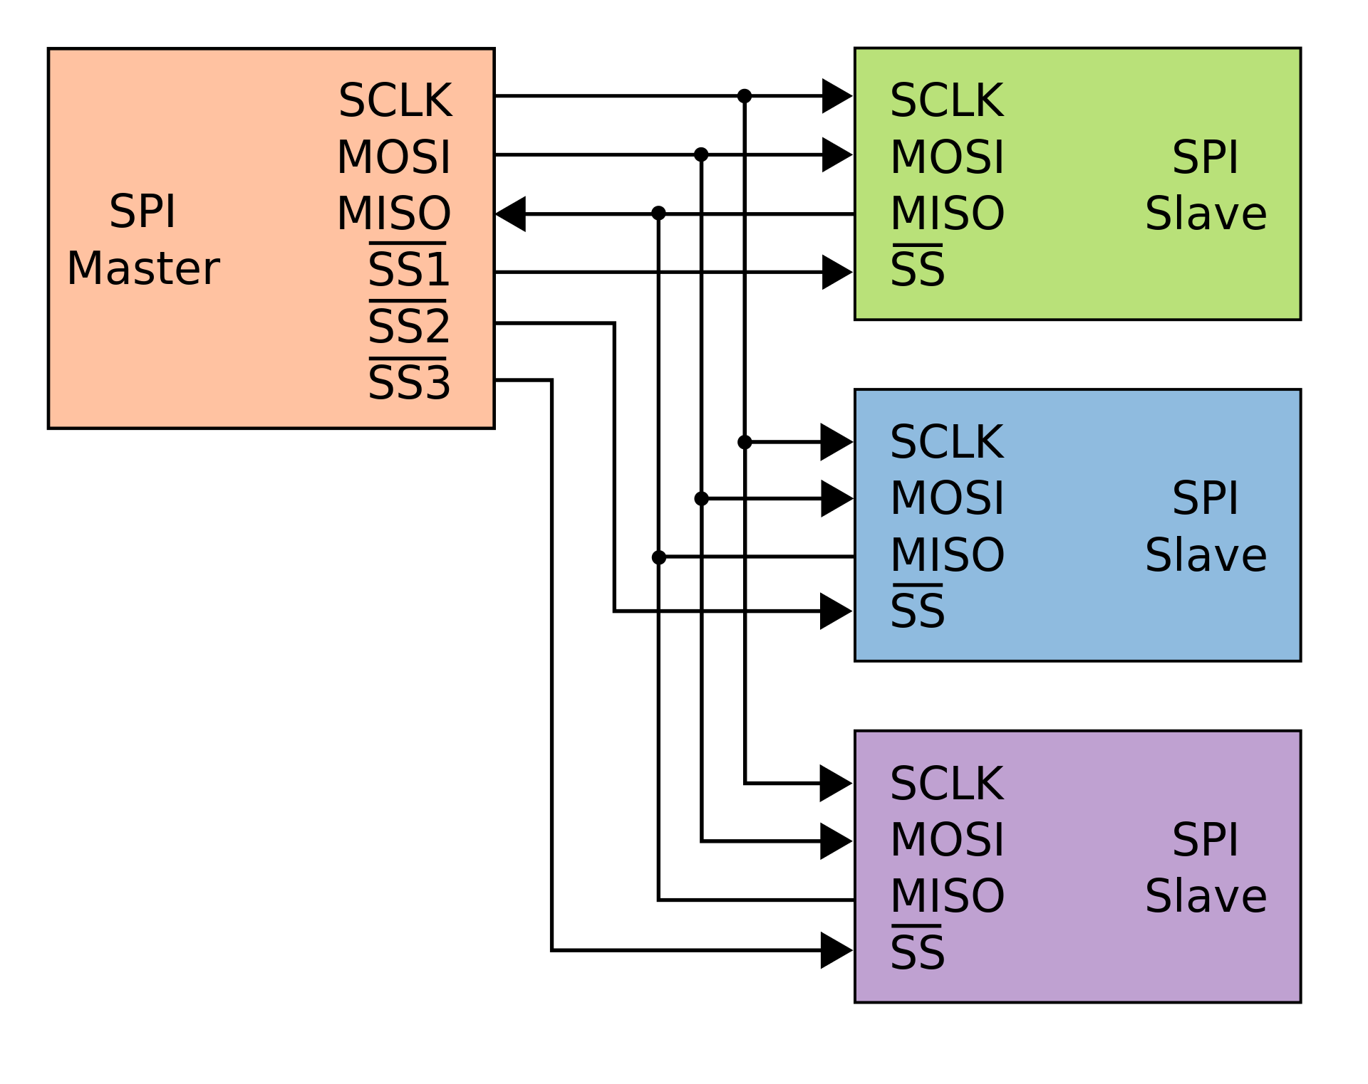
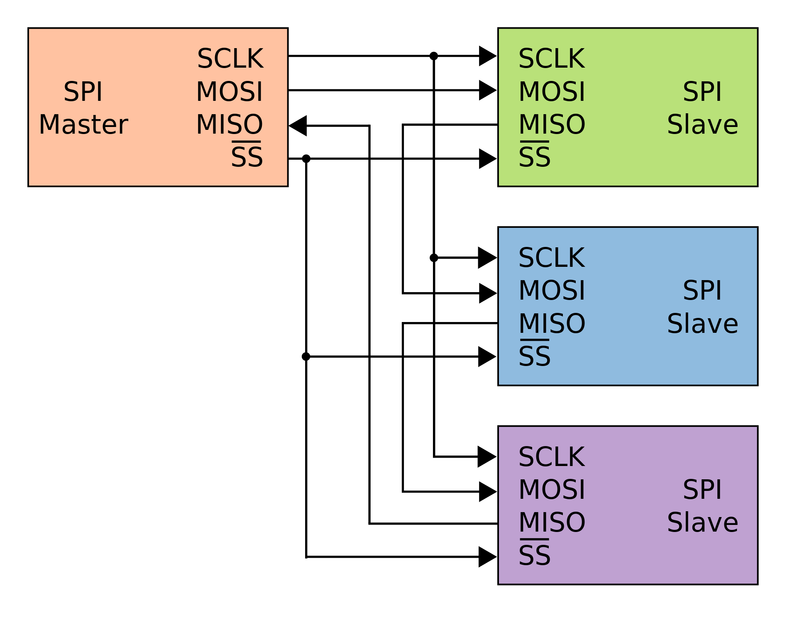
Interfaces

Slide 4
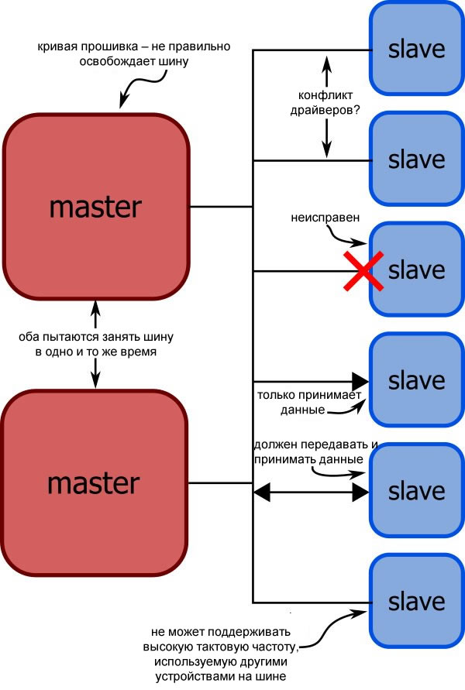
Interfaces

Slide 5

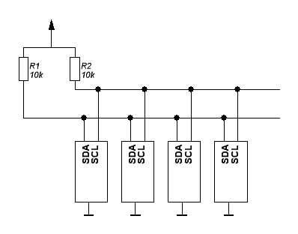
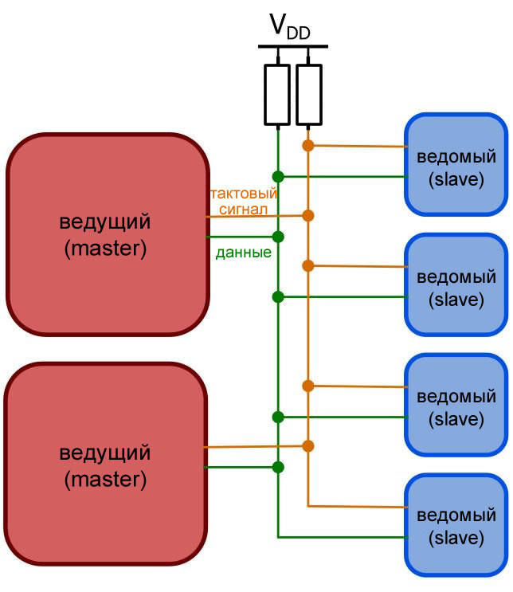
Inter-integrated circuit (I2C/IIC)

Slide 6
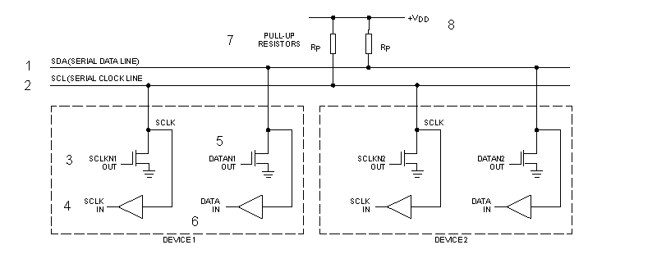
Inter-integrated circuit (I2C/IIC)

Slide 7
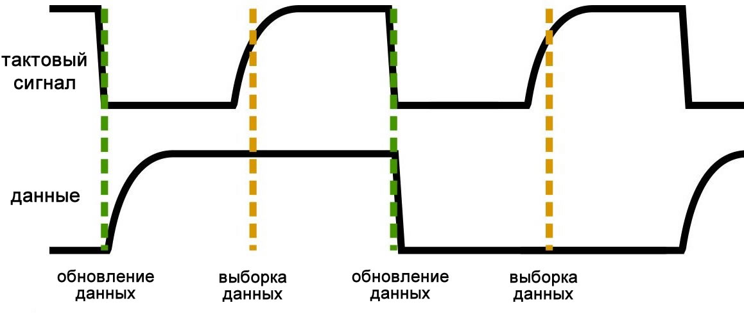
Inter-integrated circuit (I2C/IIC)

Slide 8
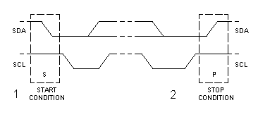
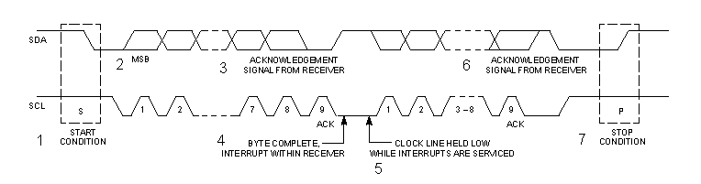
Inter-integrated circuit (I2C/IIC)

Slide 9
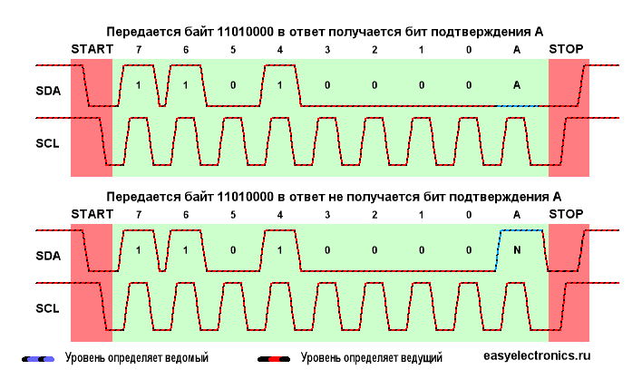
Inter-integrated circuit (I2C/IIC)

Slide 10
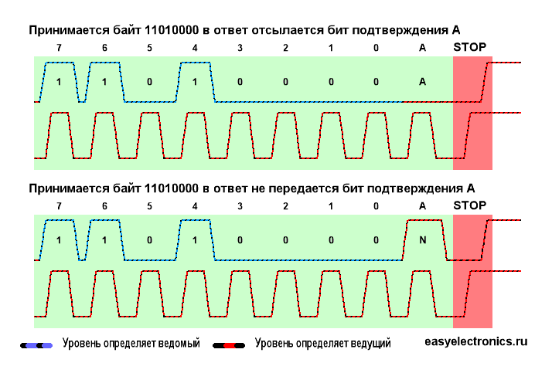
Inter-integrated circuit (I2C/IIC)

Slide 11
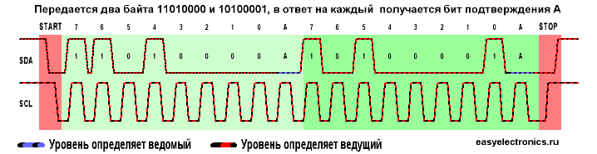
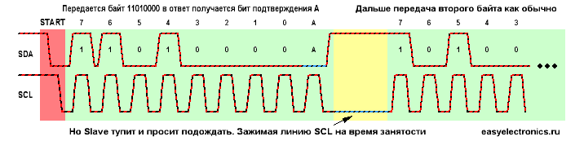
Inter-integrated circuit (I2C/IIC)

Slide 12
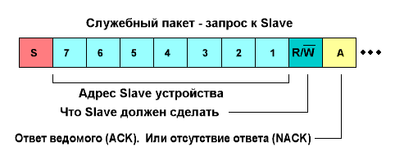
Inter-integrated circuit (I2C/IIC)

Slide 13
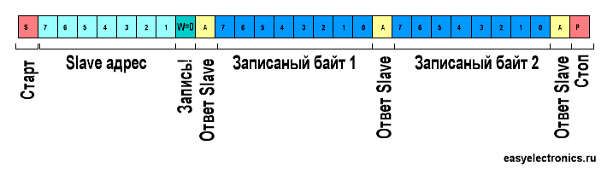
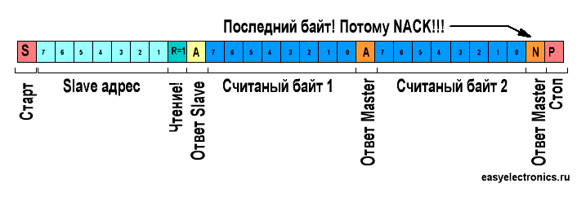
Inter-integrated circuit (I2C/IIC)

Slide 14
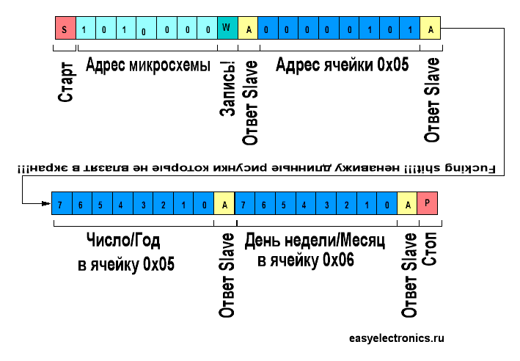
Inter-integrated circuit (I2C/IIC)

Slide 15
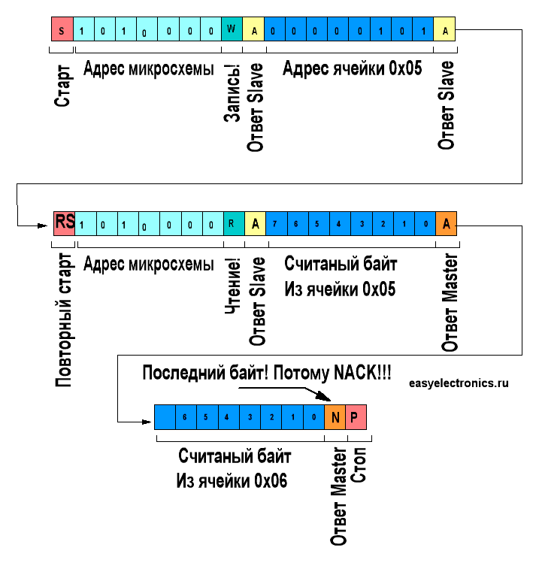
Inter-integrated circuit (I2C/IIC)

Slide 16
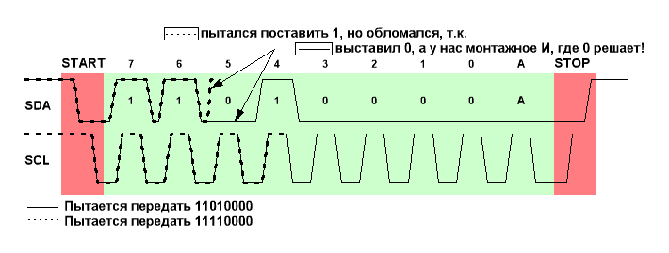
Inter-integrated circuit (I2C/IIC)

Slide 17
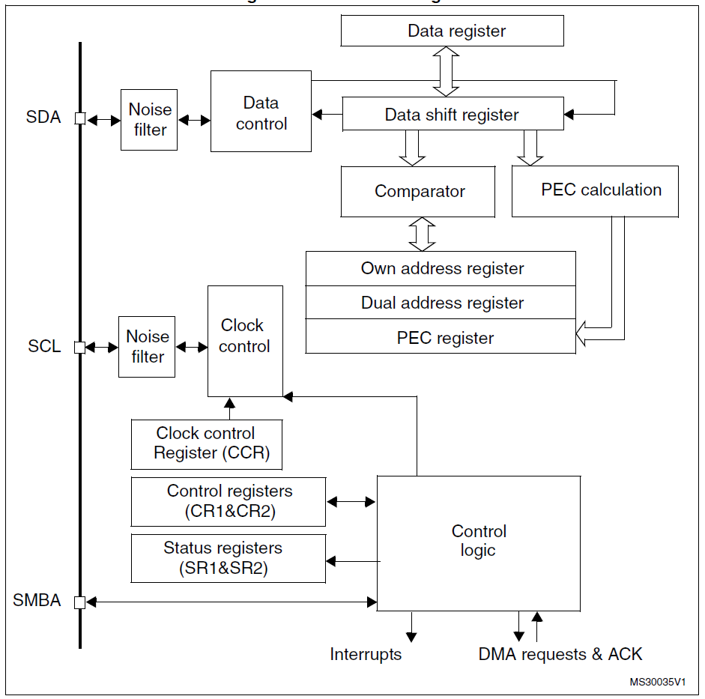
STM32 I2C

Slide 18
I2C registers
I2C Control register 1 (I2C_CR1)
I2C Control register 2 (I2C_CR2)
I2C Own address register 1 (I2C_OAR1)
I2C Own address register 2 (I2C_OAR2)
I2C Data register (I2C_DR)
I2C Status register 1 (I2C_SR1)
I2C Status register 2 (I2C_SR2)
I2C Clock control register (I2C_CCR)
I2C TRISE register (I2C_TRISE)
I2C FLTR register (I2C_FLTR)

Slide 19
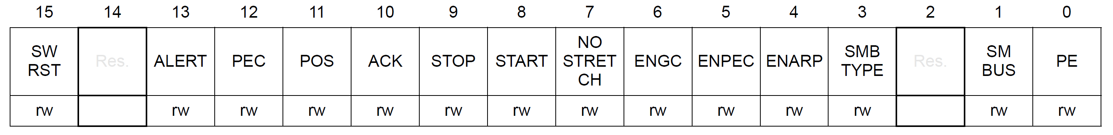
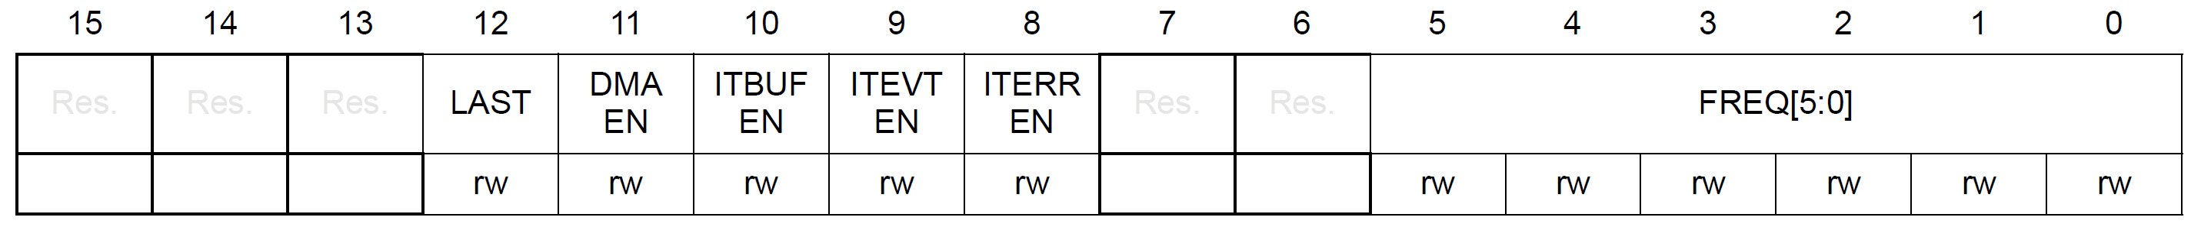
I2C registers
I2C control register 1 (I2C_CR1)
Address offset: 0x00
I2C control register 2 (I2C_CR2)
Address offset: 0x04

Slide 20
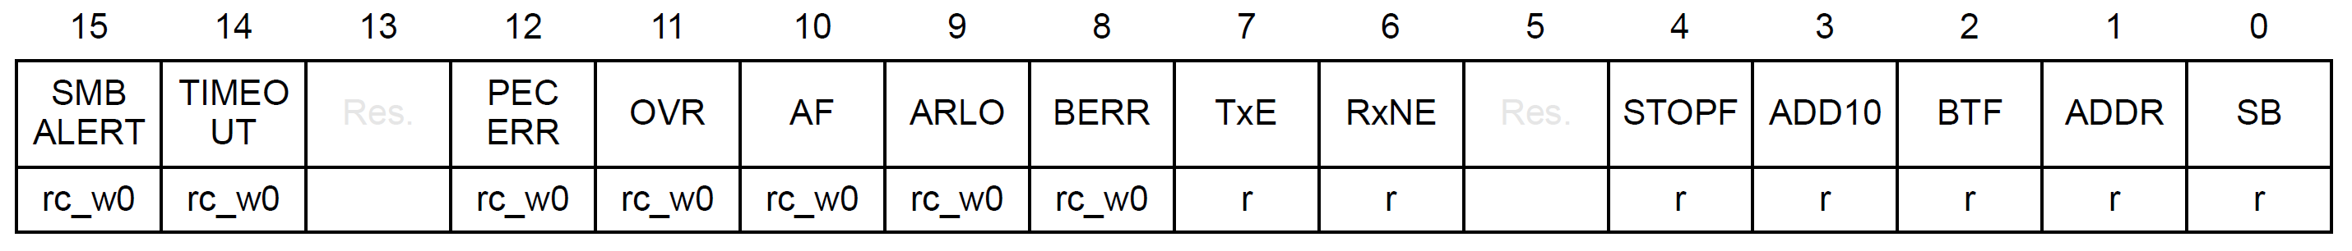
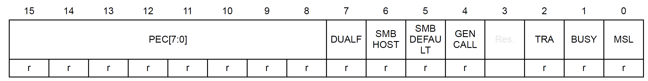
I2C registers
I2C Status register 1 (I2C_SR1)
I2C Status register 2 (I2C_SR2)

Slide 21
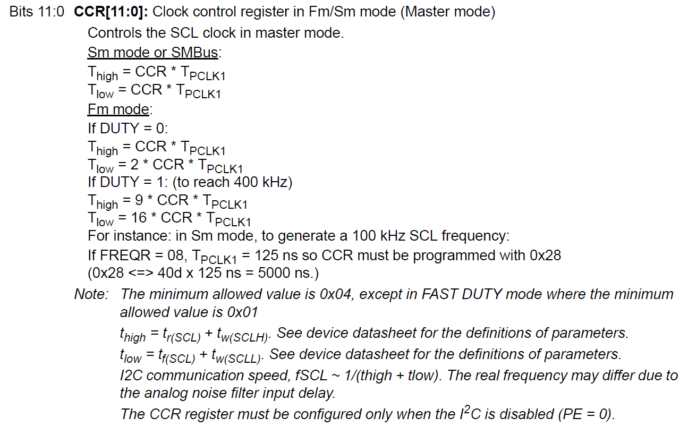
I2C registers
I2C Clock control register (I2C_CCR)

Slide 22
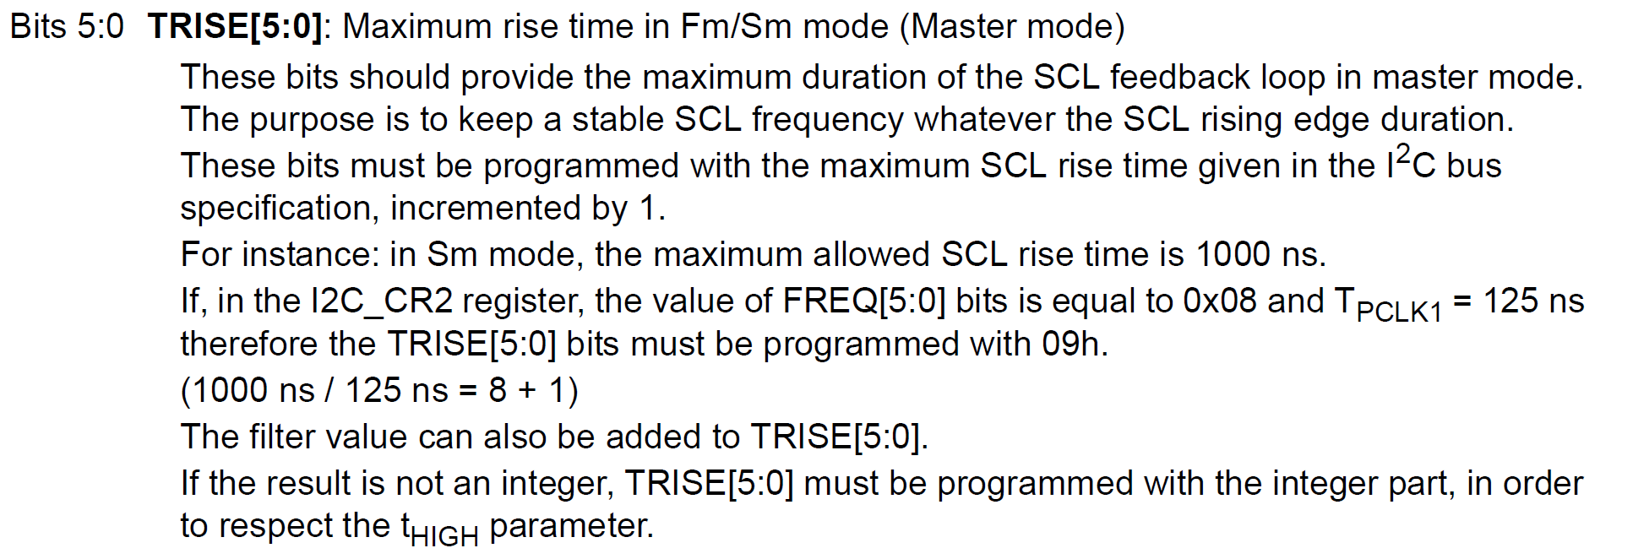
I2C registers
I2C TRISE register (I2C_TRISE)

Slide 23
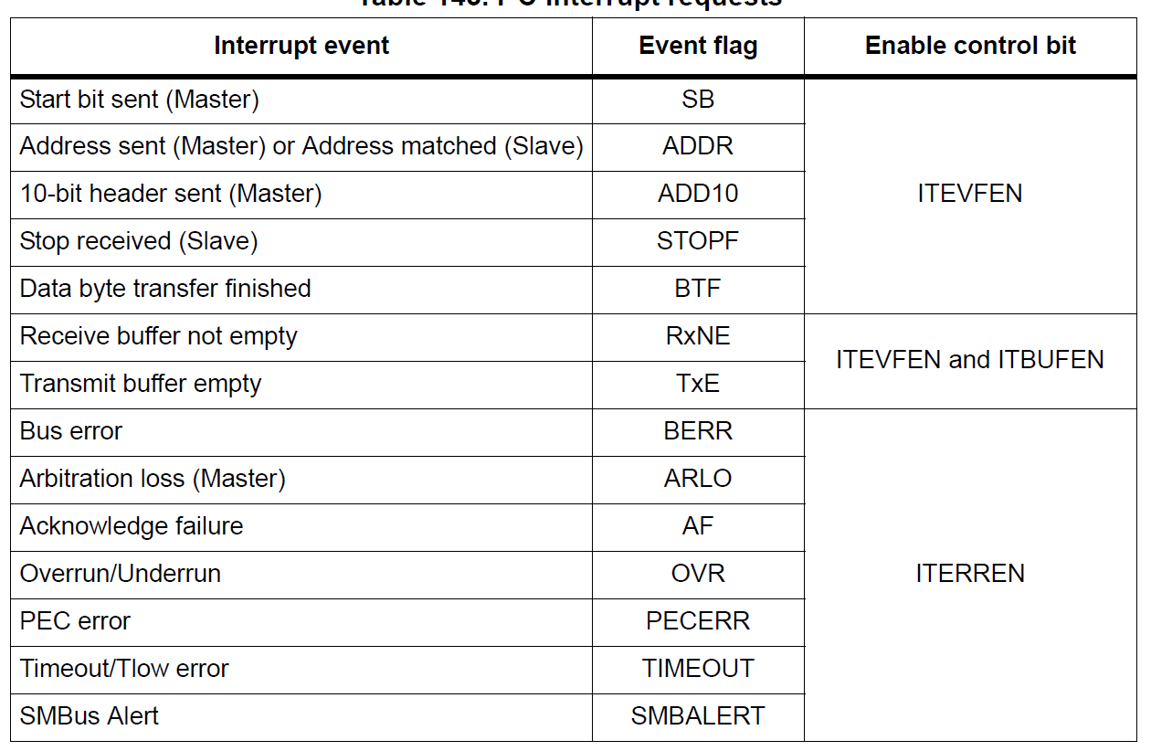
I2C Events

Slide 24

Thank you for attention
www.ifmo.ru

